Slide 1
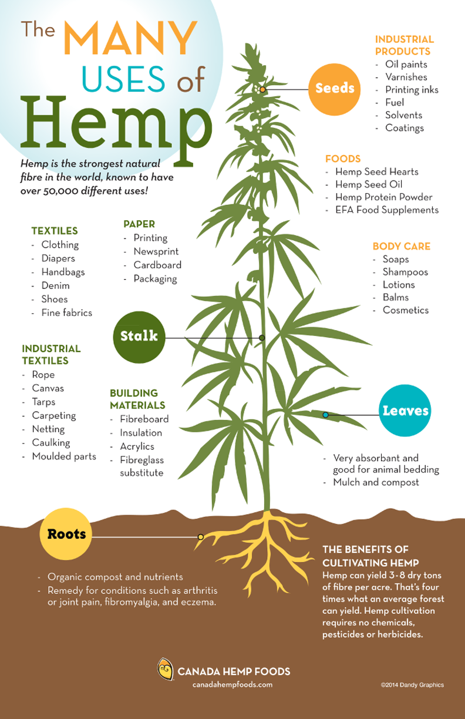
The Death of Oil-based Plastic
Introduction
New Ideas
Proposed Solution
There is between 75 and 199 million tons of plastic in the ocean
It is estimated to cause over 1 million marine animal deaths per year
Single use plastics are used in almost all products:
Cereal, chips, candy, Amazon packages, milk jugs, trash bags, shower curtains, and much more
Move back to paper and glass containers/packaging
Use hemp to create paper products, to avoid further deforestation
Use hemp to create hemp-based plastic products, when plastic is the best solution to a problem
Require manufacturers to make their products easier to recycle
Require manufacturers to use hemp-based plastic and paper
Increase hemp crops to meet new demand for hemp products
Attack the overflow of oil-based plastic waste to help the environment become cleaner
Benefits
One acre of hemp can yield over three times the amount of fiber pulp as an acre of trees, to be used for paper
One acre of hemp yields double the amount of oil one acre of peanuts produces
Biodegrades within an average of twelve months, as opposed to oil-based plastics taking between twenty and five hundred years
One ton of hemp is capable of absorbing 1.6 tons of CO2, making it very capable of cleaning the atmosphere
History
First plastic bag patented in 1965, by Celloplast in Sweden
Plastic bags began to take over in 1979 in the United States
In 1982, Kroger and Safeway switched their bags to plastic bags due to its cheap price
We moved away from paper products due to fears of deforestation
Current Technology
Single use plastics are still commonly used today for everyday items
Aluminum packaging, such as cans for food and drink
Current plastic materials are petroleum based
References
“From Birth to Ban: A History of the Plastic Shopping Bag.” UNEP, www.unep.org/news-and-stories/story/birth-ban-history-plastic-shopping-bag. Accessed 26 Nov. 2024.
“Hemp Resources.” National Hemp Association, 29 Dec. 2023, nationalhempassociation.org/hemp-resources/.
Portilla, Nicolle. “Plastic Pollution in the Ocean - 2024 Facts and Statistics.” Recycle Track Systems, 30 Dec. 2023, www.rts.com/blog/plastic-pollution-in-the-ocean-facts-and-statistics/#:~:text=How%20Much%20Plastic%20Is%20in,marine%20environment%20every%20single%20year.
“Why Hemp Plastic: The Benefits of Hemp Plastic.” The Hemp Plastic Company, 31 May 2023, hempplastic.com/facts/.
“Why Hemp?” Bean Products, beanproducts.com/pages/why-hemp#:~:text=One%20acre%20of%20hemp%20produces,can%20be%20produced%20from%20hemp. Accessed 26 Nov. 2024.

